Slide 1

Lung Cancer Detection System Using CNN
Name : Pawan Kumar K.P
USN : 4SO23MC068
4th Semester MCA
Internal Guide:
Ms. Sumangala N
Asst Professor
Department of Computer Applications

Slide 2
Company Profile
Accolade Tech Solutions Pvt. Ltd. is a well-regarded software and web development company headquartered in Mangalore, India.
With extensive industry experience, deep technological expertise, and a broad range of services, Accolade Tech Solutions enables clients to enhance their business operations.
The company offers comprehensive IT consulting services, guiding organizations on effectively leveraging technology to meet their business goals.

Slide 3
Introduction to the Project
Abstract
This project presents a deep learning-based Lung Cancer Detection System designed to classify CT-scan images into benign, malignant, or normal categories using Convolutional Neural Networks (CNNs).
The system addresses limitations in traditional diagnostic methods by providing automated, accurate, and real-time analysis of medical images. Integrated with a web-based interface, it allows patients to upload scans and receive immediate diagnostic feedback, while doctors can access detailed reports and manage patient records.
The system is built using open-source tools including Flask, TensorFlow, and MySQL, making it cost-effective and scalable. Designed with a focus on usability, data security, and clinical relevance, this solution aims to enhance early cancer detection, streamline medical workflows, and support informed decision-making in healthcare environments.

Slide 4
SRS Details
Objective: To develop a machine learning-based web application that classifies lung CT-Scan images into benign, malignant, or normal categories, enabling early and accurate cancer detection with minimal manual intervention.
Intended Users:
Patients – Upload scans, receive results.
Doctors – View predictions, provide medical notes.
Admins – Manage users and oversee operations.
Goals:
Automate cancer detection using CNNs.
Reduce diagnostic time and manual errors.
Generate downloadable PDF reports.
Provide secure, role-based access.
Ensure compliance with healthcare data privacy.

Slide 5
SRS Details
Functional Requirements:
User Module: Registration, login, image upload, prediction view, PDF download.
Doctor Module: View patient history, add recommendations, manage profiles.
Admin Module: Manage user accounts, system monitoring, access control.
Prediction System: Classify images using a trained CNN model.
Non-Functional Requirements:
Performance: Fast processing with real-time feedback.
Security: Encrypted storage and SSL-based communication.
Usability: Clean UI, responsive design, minimal training required.
Portability: Compatible with Windows/Linux, major browsers.
Maintainability: Modular codebase using open-source tools (Flask, TensorFlow).
Scalability: Designed to support future integrations and larger datasets.
Tech Stack: Python, Flask, MySQL, TensorFlow, OpenCV, Bootstrap, FPDF

Slide 6
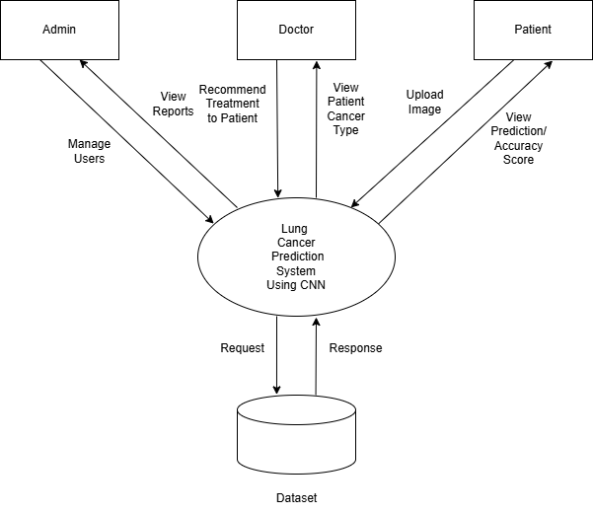
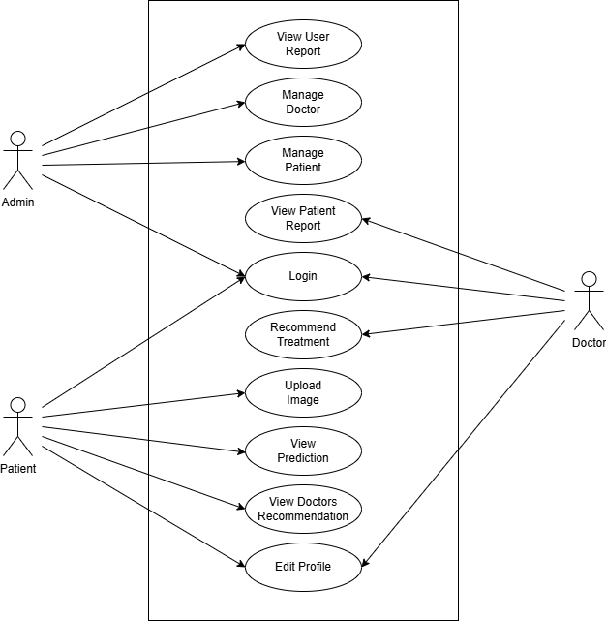
Design Documents
System design is a crucial stage in software development. It focuses on identifying the necessary modules, defining their functions, and outlining how they interact to deliver the intended outcome. This phase transforms user requirements into specific system features. It covers both the logical framework and the physical structure of the system. The logical design outlines elements like input files, output files, and databases, ensuring they align with project goals. Overall, this process helps clarify the structure and workflows needed to successfully build and implement the system.
Context Flow Diagram
Use Case Diagram

Slide 7
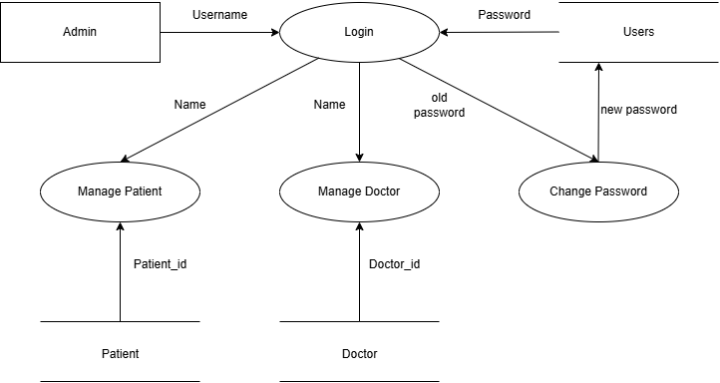
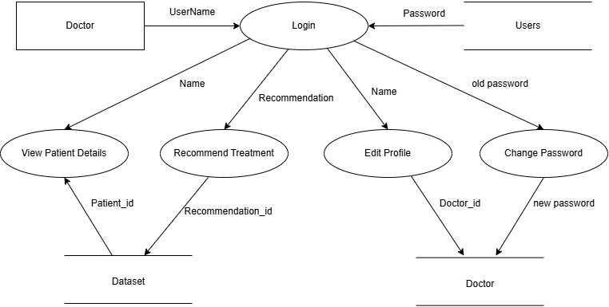
Design Documents
Admin DFD
Doctor DFD

Slide 8
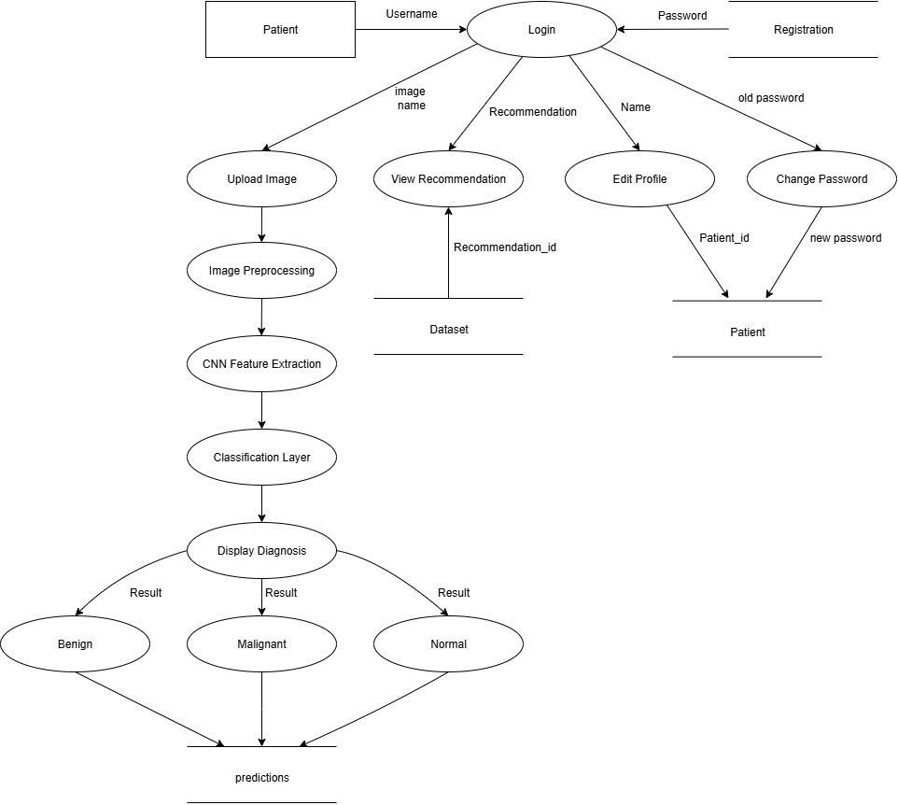
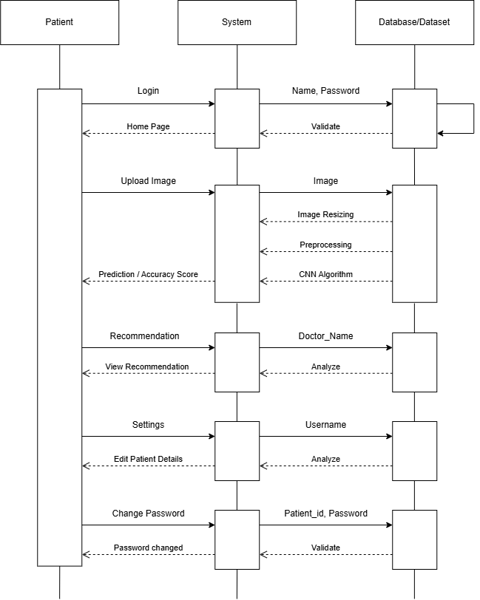
Design Documents
Patient DFD
Patient Sequence Diagram

Slide 9
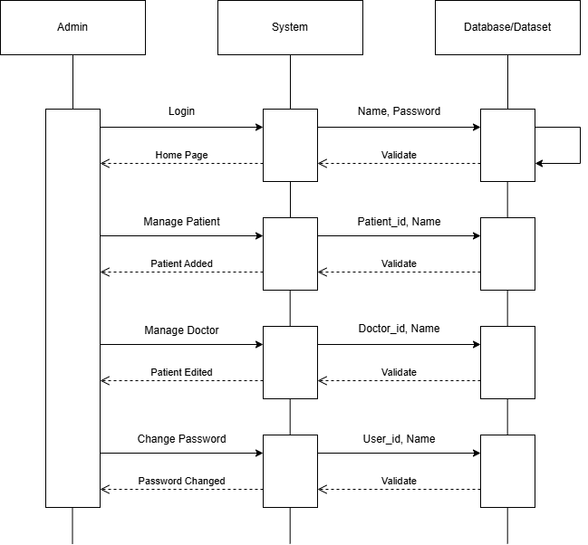
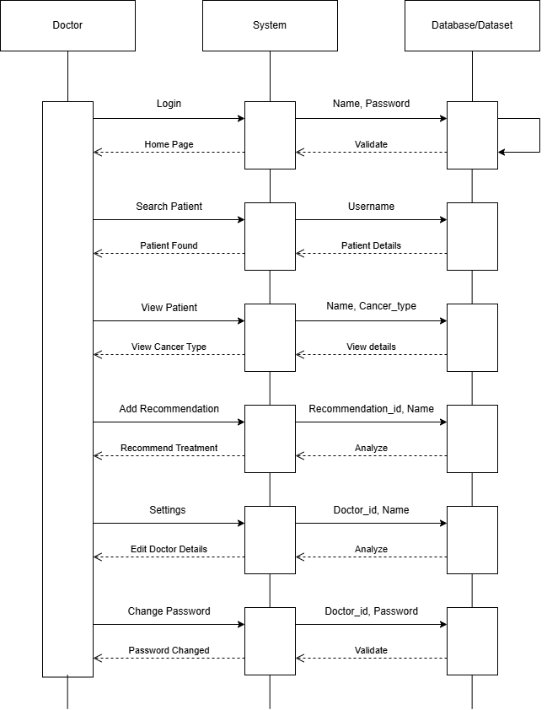
Design Documents
Admin Sequence diagram
Doctor Sequence diagram

Slide 10
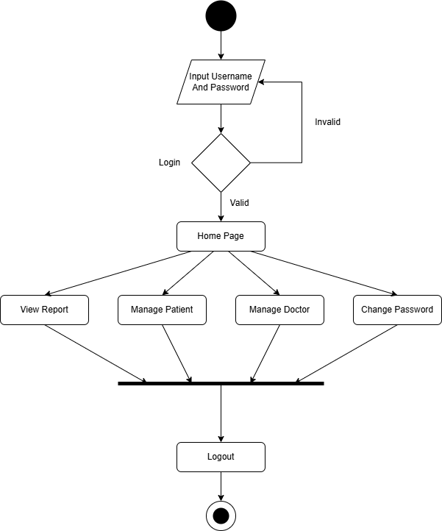
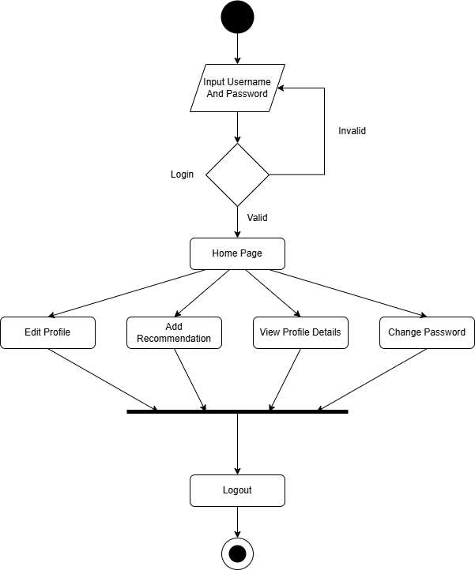
Design Documents
Admin activity diagram
Doctor activity diagram

Slide 11
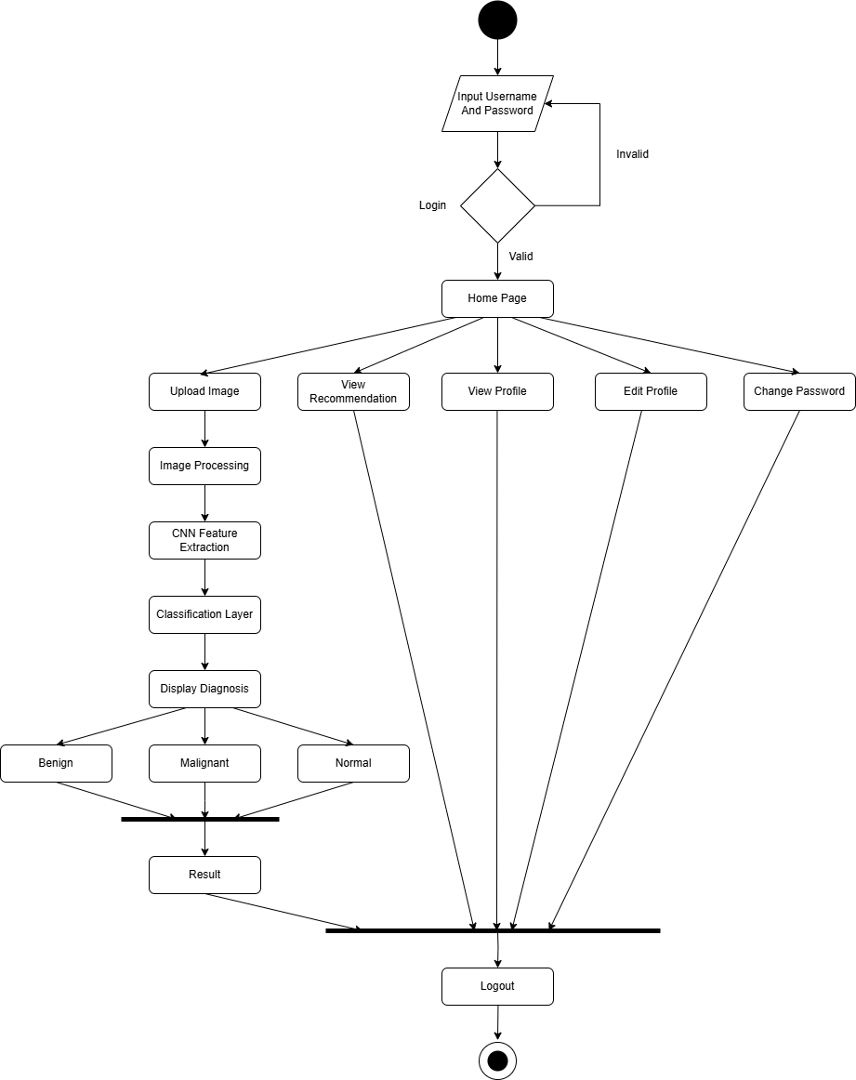
Design Documents
Patient activity diagram

Slide 12
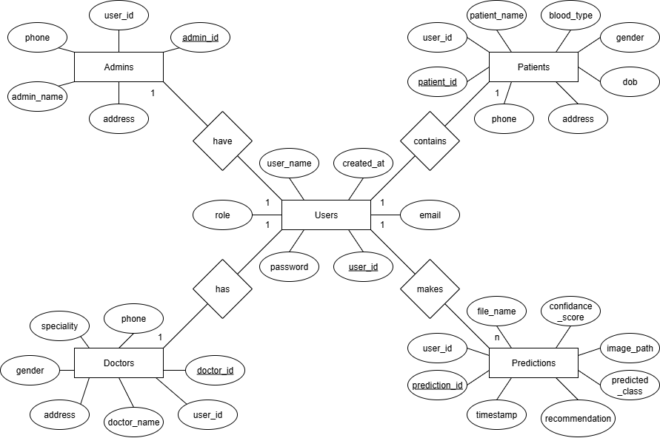
Design Documents
ER - diagram

Slide 13
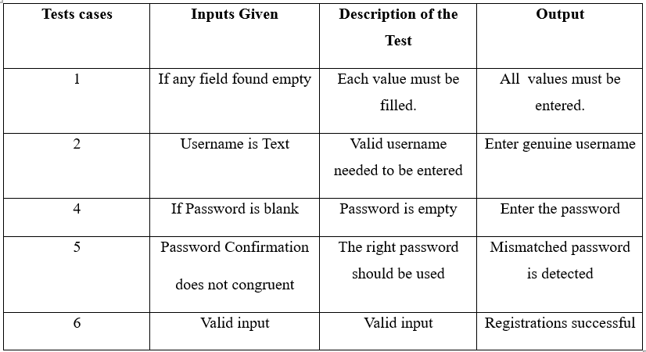
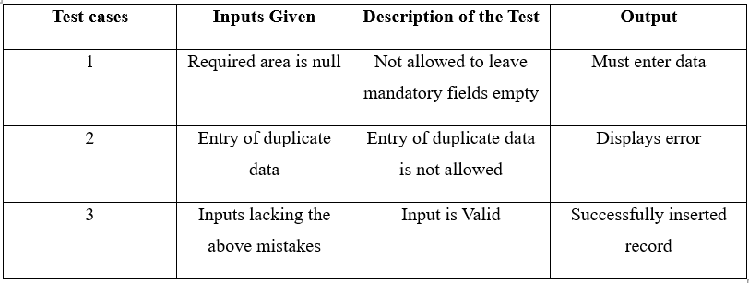
Testing and Implementation
Testing is a crucial procedure used to guarantee the accuracy, comprehensiveness, and caliber of software. By locating and fixing software bugs, it contributes significantly to a system's success.
TESTING FOR REGISTRATION
TESTING IF INSERTION OF DATA IS VALID
Table 7.3.5 Testing for registration

Slide 14
Testing and Implementation
Executing a plan is the process of implementation. It involves an overview, a brief description, and the tasks required to carry out the implementation. During this phase, various test cases are evaluated and integrated into the system.
PSEUDO CODE FOR LUNG CANCER DETECTION
Begin
Input: High-resolution CT-Scan images
Preprocess the images:
Apply normalization
Perform noise reduction
Apply contrast enhancement
Standardize image size and resolution
Extract features:
Identify texture, shape, density, and cancer size
Analyze using Convolutional Neural Network (CNN) features:
Classify cancer as benign or malignant based on trained dataset
If cancer is malignant:
Recommend further medical evaluations and treatment
Else if cancer is benign:
Suggest routine monitoring and preventive measures
End

Slide 15
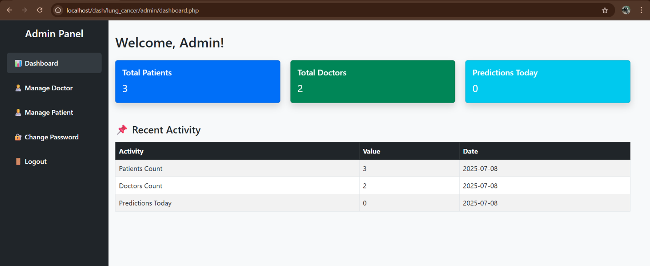
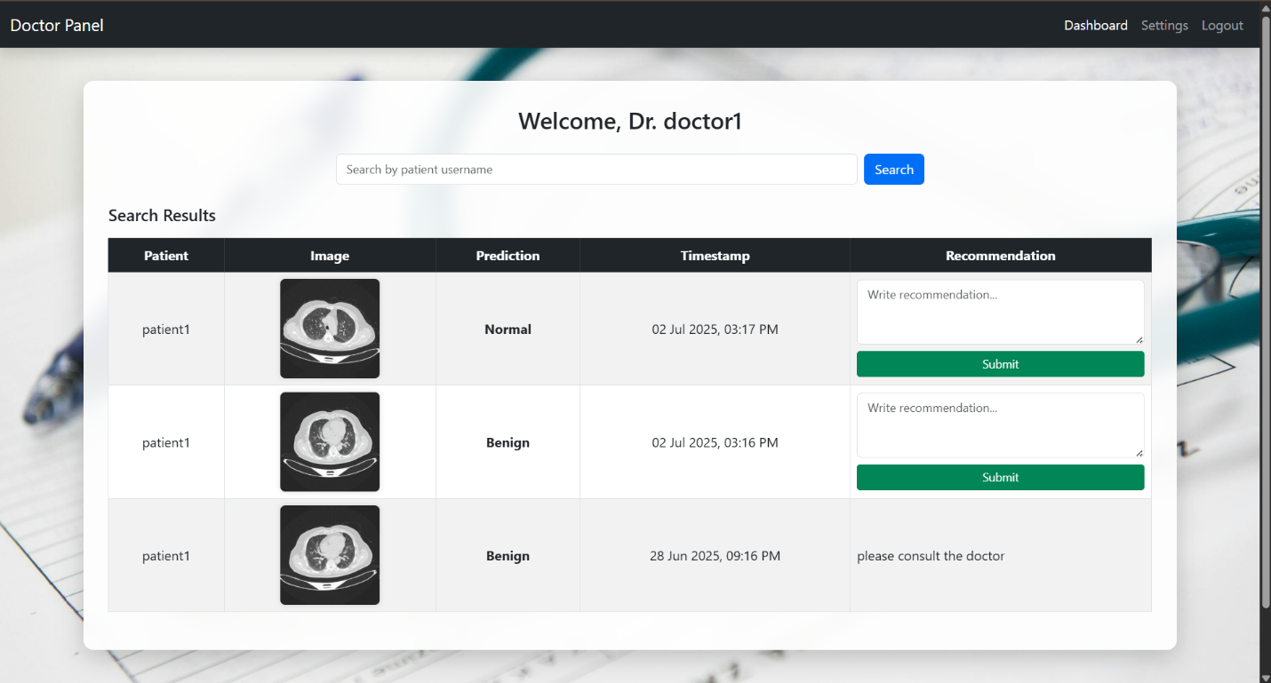
Screenshots
Admin Dashboard
Doctor Home Page

Slide 16
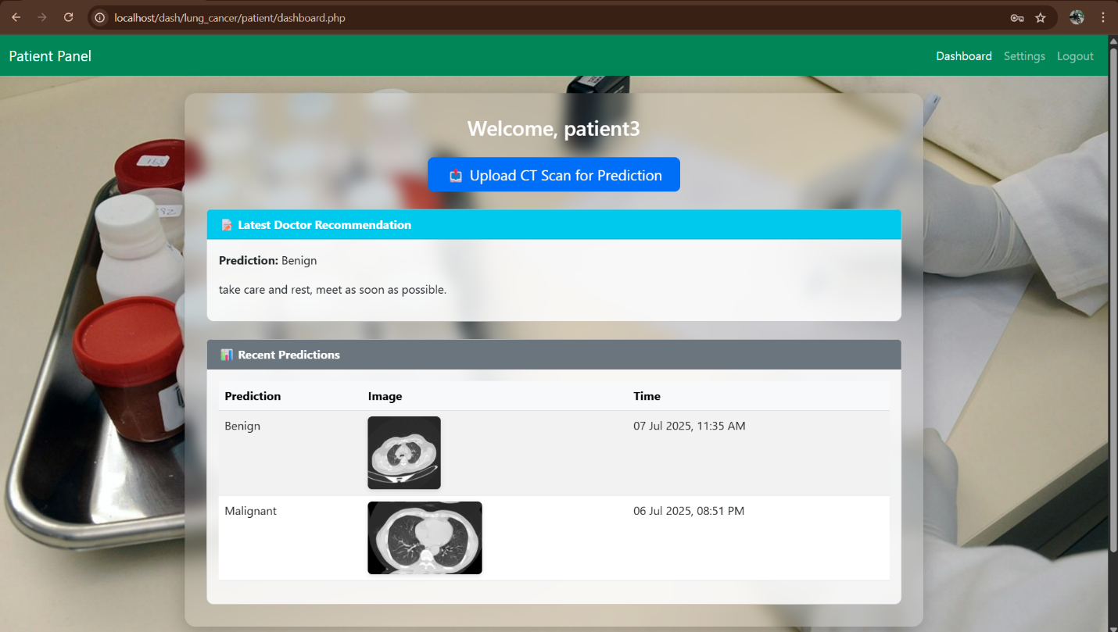
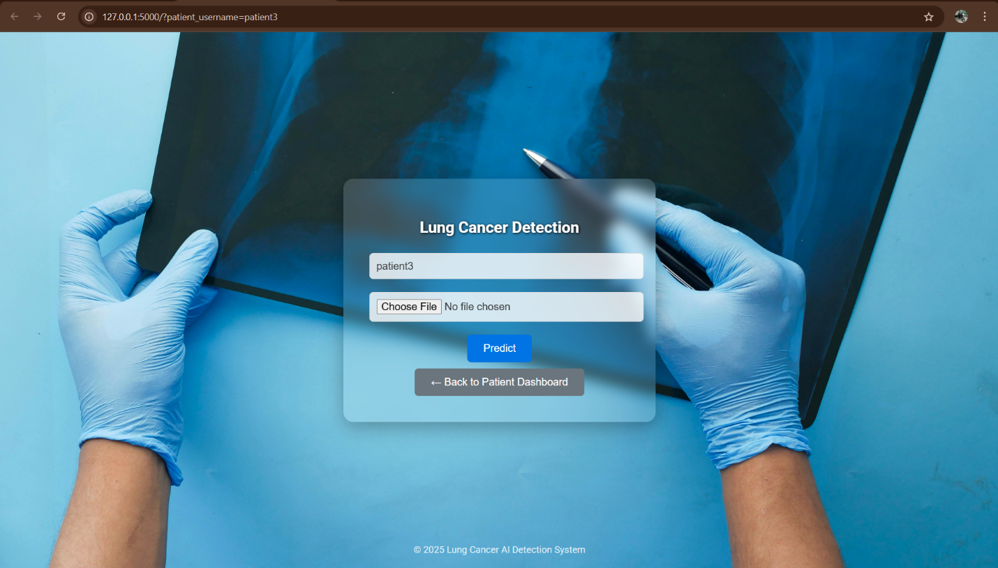
Screenshots
Patient Home Page
ML Prediction Page

Slide 17
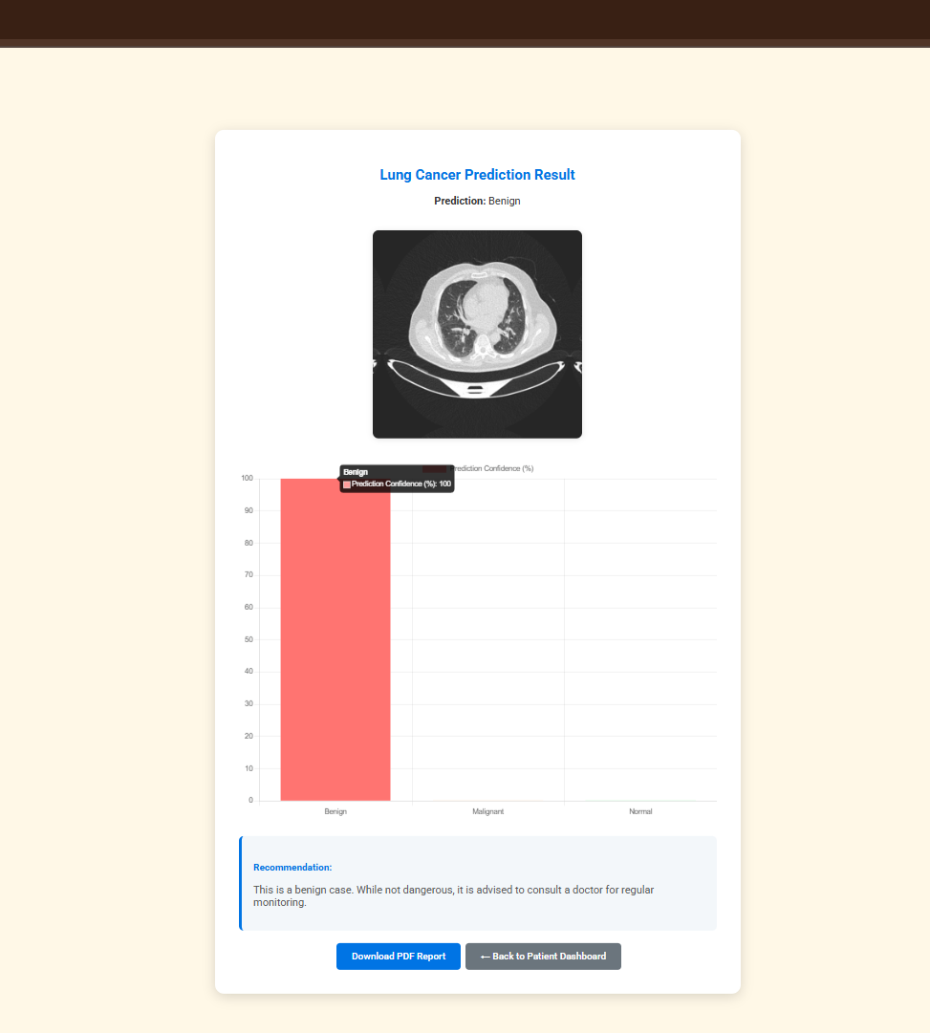
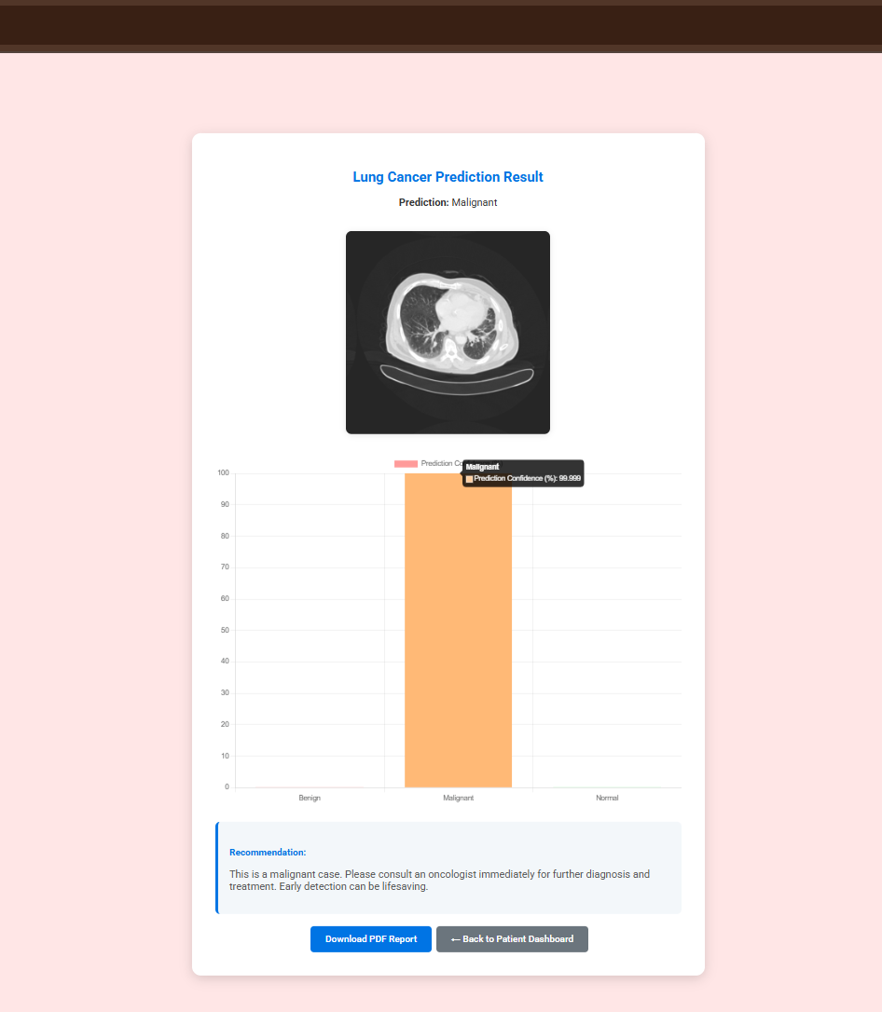
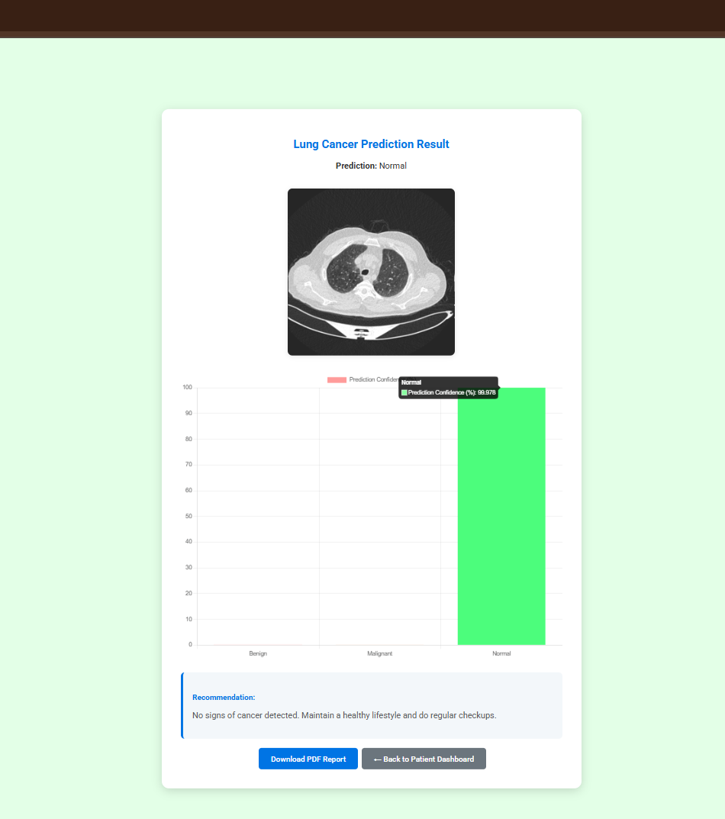
Screenshots
Benign Case Prediction
Malignant Case Prediction
Normal Case Prediction

Slide 18
Conclusion
The Lung Cancer Detection project utilizing Convolutional Neural Networks (CNNs) marks significant progress in medical diagnostics by applying advanced deep learning techniques to classify CT scan images into benign, malignant, or normal categories. The CNN-based model addresses the shortcomings of traditional manual analysis and rule-based systems, offering a scalable and highly accurate approach for early detection of lung cancer.
With a user-friendly interface and consistent performance across various datasets, the system improves the overall diagnostic process for doctors, patients, and healthcare staff. Its design integrates automated preprocessing, real-time predictions, and structured result generation, making it practical and dependable in clinical use.
Beyond aiding in early detection, this solution highlights the potential of AI-driven healthcare tools. It demonstrates how technology can play a vital role in enabling faster decisions and more efficient patient care, contributing meaningfully to the fight against lung cancer.

Slide 19
Thank You

